Slide 1

SWIGGY Data Analysis
Presented by:
Pd18_067 Harshal Chopade
Pd16_144 Avinash Kumar
Pd16_205 Rajat Rout
Pd16_256 Shankar Pradhan

Slide 2

Primary Objective
To collect data from the food delivery platform SWIGGY using web scraping and analyze the data to generate insights and recommendations for the end user. This may involve analyzing restaurant information, such as ratings, cuisine, and pricing.

Slide 3

Goals:
To generate insights that can be used to make informed decisions about opening a remote kitchen in Bangalore
To provide insights for the broader food delivery industry, such as area-wise distribution of restaurants, cheap and expensive restaurants for each type of cuisine, and the number of restaurants for each type of cuisine

Slide 4
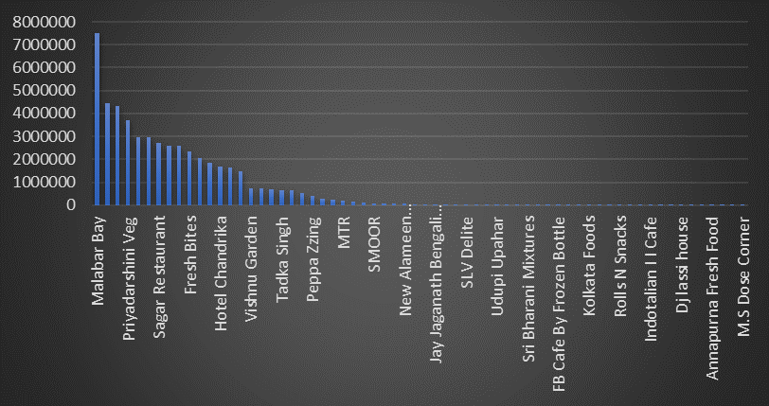
Most Popular Restaurant by Rating

Slide 5
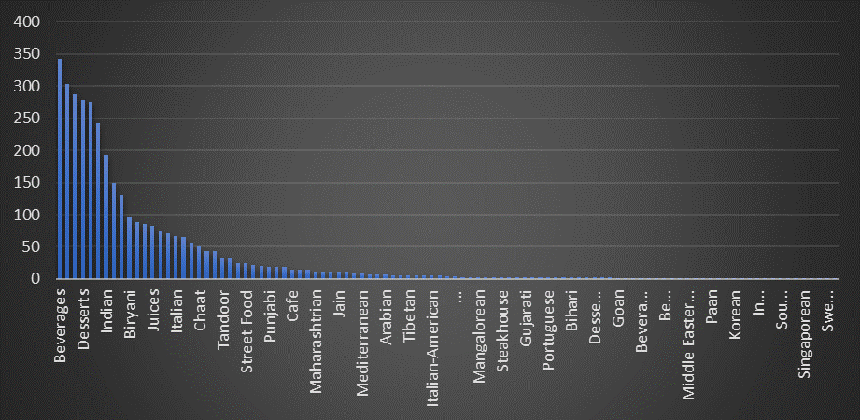
Number of Restaurant for Each Cuisine

Slide 6
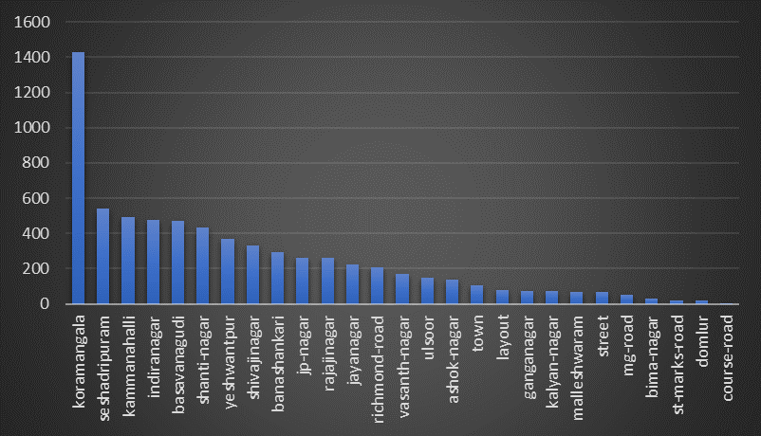
Number of Restaurant above 1K Rating in Different Location

Slide 7
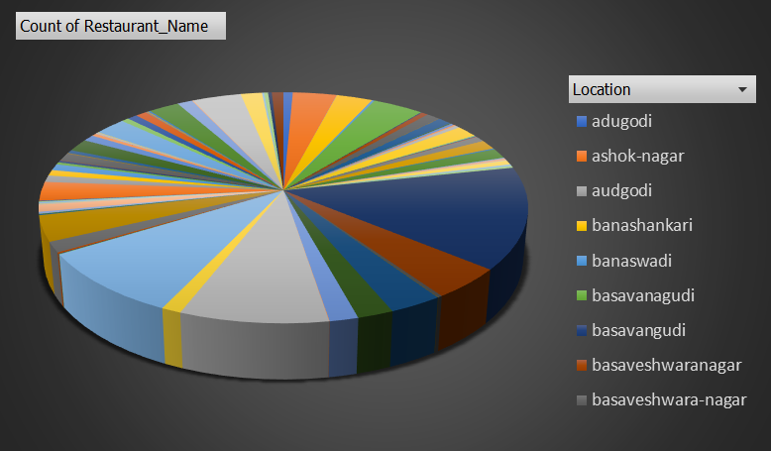
Area wise Restaurant Distribution

Slide 8
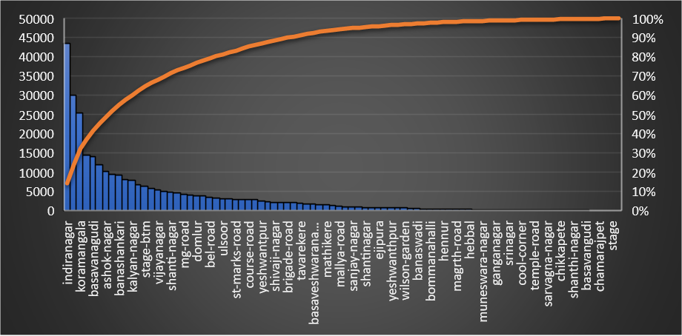
Area wise Expensive & Cheap Restaurant based on Average Dish Price

Slide 9
Important Insights:
Beverages, Desserts, Indian & Biryani cuisine has the greatest number of restaurants
Clients can keep dishes related to this cuisine so that more consumers will get attracted to their restaurant
Most popular restaurant by ratings: Malabar Bay
Adugodi, Basavana Gudi, Basaveshwara Nagar - These areas have more number of restaurants, we can assume that more consumers are from these areas
Indira Nagar, Koramangala, Basaveshwara Nagar has a greater number of expensive restaurants based on average price and

Slide 10
Challenges Faced:
Collecting data from single platform for different restaurants was time consuming.
Getting data well and consistent across different sources requires careful data cleaning and processing.
Lesson Learned:
Web Scrapping can be effective tool for collecting larger amount of information but it requires careful consideration of legal & ethical issues.
Data Cleaning & processing are important steps in data analysis, investing time & effort can prevent many headaches.
Good data visualization is essential to convey understanding to stakeholders or clients.

Slide 11
Future Scope:
Expand analysis in other region
Incorporate external factors: External factors such as weather, events, or holidays
Collaborate with restaurants or food delivery platforms
Incorporate more data sources

Slide 12

Thank You...

